Slide 1
FOREST COBUSTION RECOGNITION USING AI
- Done By
K Dhanith Krishna
17MIS7013

Slide 2
Abstract
This project is aimed at the areas where the fire combustion takes place to save the wildlife animals and people situated around. A large forest fire causes a serious impact on the environment, determining its future for decades. Prevention of forest fires is one of today's most important tasks as well as appropriate preparedness for effective fighting against them. To do so, it is vital to have detailed knowledge on AI, deep learning techniques (CNN) to visualize/recognize whether the forests are with fire or without fire through the images which we give the model to predict.

Slide 3
Objective
The main objective of our project is to control forest fires and strengthen the forest protection and create a user-friendly environment where anyone should be able to use. Also, they should be able to access the software from anywhere and anytime.

Slide 4
Introduction
Forest fires are a major environmental issue, creating economic and ecological damage while endangering human lives. There are typically about 100,000 wildfires in the United States every year. Over 9 million acres of land have been destroyed due to treacherous wildfires. It is difficult to predict and detect Forest Fire in a sparsely populated forest area and it is more difficult if the prediction is done using ground based methods like Camera or Video Based approach. Satellites can be an important source of data prior to and also during the Fire due to its reliability and efficiency. Forest fires destroy a total area of 3.5 to 4.5 million km. Here we are going to train the model in such a way that if you give an image/picture of the forest it will detect whether the forest is with fire or without fire. And if it recognizes the fire picture it puts on an alarm sound. This helps us to find out the forest combustion in an easy way by staying even at home.

Slide 5
Overview
Environment is major wealth of our country. Forests provide enormous material goods and environmental services. They are useful for industry as well as rural economic growth. At the same time, when the forest is under fire it emits lot of carbon dioxide leads to climate change and global warming. So the forest fire has to be detected at earlier stage. For example, recently we have seen forest fires in Australia. Approximately 18,636,079 hectares (46,050,750 acres) off forest area had undergone combustion. So, due to isolation, inaccessibility, tough weather, shortage of frontier staff, the early finding of forest fire is a difficult task we have developed a model to detect forest fire combustion. Anyways to do it manually we need lot of man power so to overcome that we are implementing CNN (Convolutional Neural Network) Model, which is a deep learning technique to predict the fire in forest.

Slide 6
Problem Statement
By this project we are able to meet the main objectives of the client. The existing system does not make any detection of the fire of its own unless we place/have any sensors to identify them so, human has to waste their time to go and check around the forest. But new system which we are going to develop can predict the fire by using images developed by CNN (analyzing visual imagery). This can be very tedious and time consuming, resulting in users to refraining from using these applications for long periods of time. So, by using deep learning technique - CNN we are able to achieve the goal of our project.

Slide 7
Proposed Work
The proposed Forest Fire Prediction model is based on neural networks(CNN) incorporated to an alert system. The developmental approach of the proposed system includes two modules:
Forest Fire Identification: Identification of fire affected areas.
Forest Fire Management: Remedial measures for Forest Fire is all about detecting where the fire initiated in the forest.

Slide 8
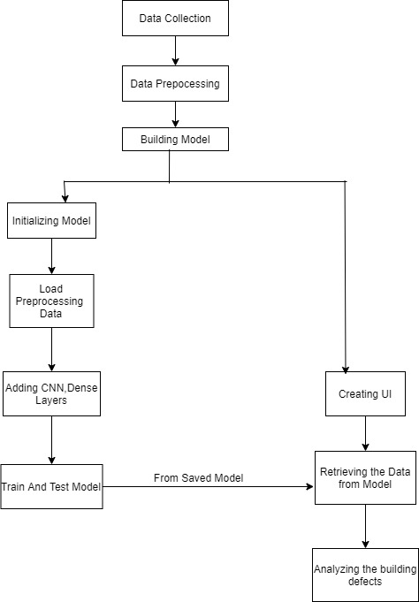
Workflow

Slide 9
Algorithm Used: CNN
In deep learning, a convolutional neural network (CNN) is a class of deep neural networks, most commonly applied to analysing visual imagery. They are also known as shift invariant or space invariant artificial neural networks, based on their shared-weights architecture and translation invariance characteristics.
In this project we are going to detect using images, so we used CNN algorithm.

Slide 10
Result & Discussion
As a result, when we uploaded an image by choosing it we will get the predict button then after clicking that the model will predict whether it is forest with fire or without fire.
It will predict as following different outputs, when we insert an image with fire we will get fire alarm in our system or it doesn’t produce any kind of sound in the system.

Slide 11
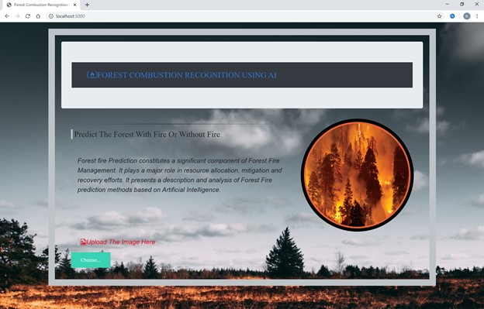
Homepage

Slide 12
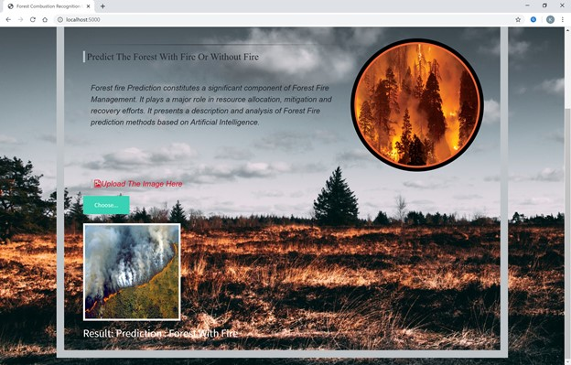
Result: Forest With Fire

Slide 13
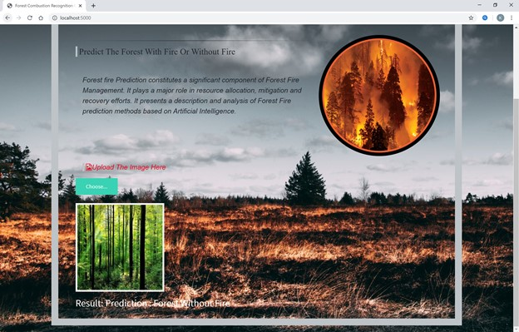
Result: Forest Without Fire

Slide 14
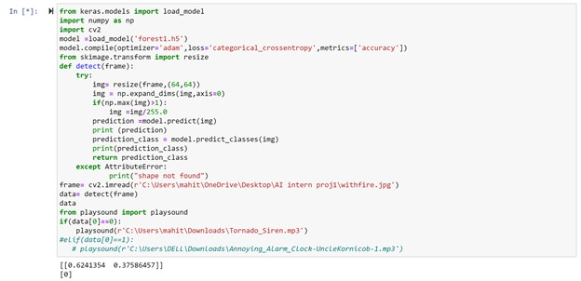
Result of Alarm in Jupyter notebook (With Fire)

Slide 15
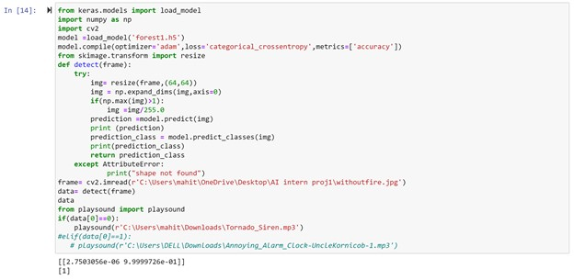
Result of Alarm in Jupyter notebook (Without Fire)

Slide 16
Conclusion
We developed this project using AI, Deep learning techniques (CNN), python3. This study proposes an effective forest fire detection method using image processing techniques. The algorithm uses Train and test model. It will train our model and further it test whether fire is present or not. Five fire detection rules are applied to detect the fire. The performance of the proposed algorithm is tested on data set consisting of various pictures of forest collected from Internet, 100 of which were actual fire pictures , while another 100 were without fire .The results show that the proposed algorithm achieves good detection rates. These results indicate that the proposed method is accurate and can be used in automatic forest fire-alarm systems.

Slide 17
References
4.3 REFERENCES
Anon, 1995. Report of the Committee of Enquiry into Forest Fires in Himachal Pradesh and Uttar Pradesh in 1995, Government of India.
Bahuguna, V.K. and Upadhyay, A., 2002. Forest fires in India: Policy initiatives for community participation; International Forestry Review, 4(2).
FAO, 2003.Wildland Fire Management Terminology. FAO Forestry Paper 70. FAO, Rome.
https://www.researchgate.net/publication/261272818_Artificial_intelligence_for_forest_fire_prediction
https://ieeexplore.ieee.org/document/5695809/metrics#metrics

